Slide 1



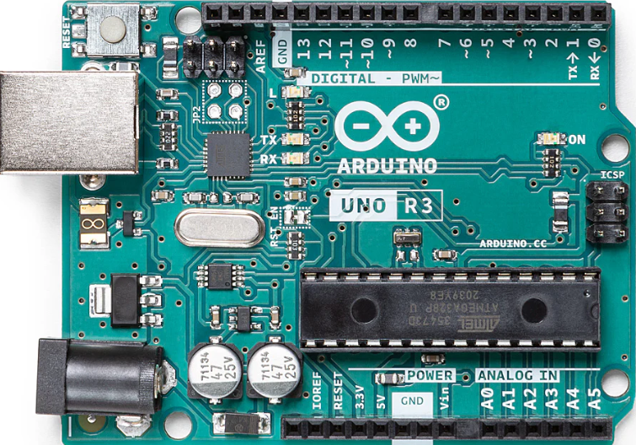
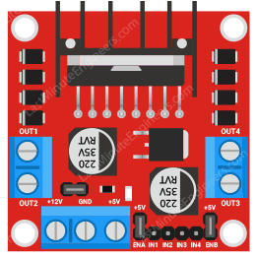
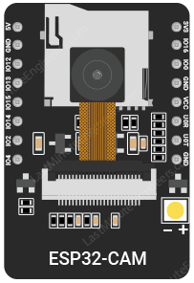
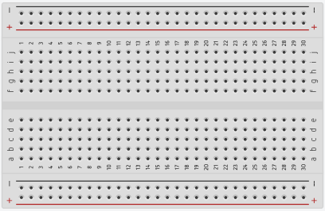
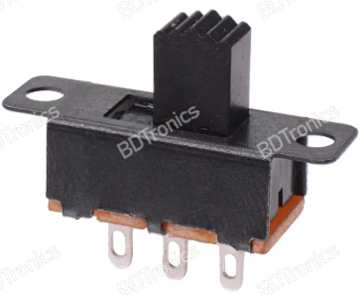
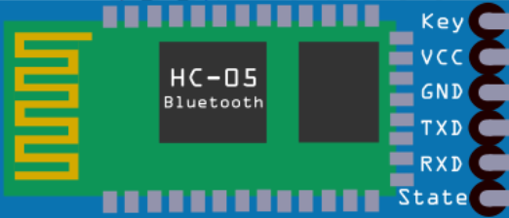
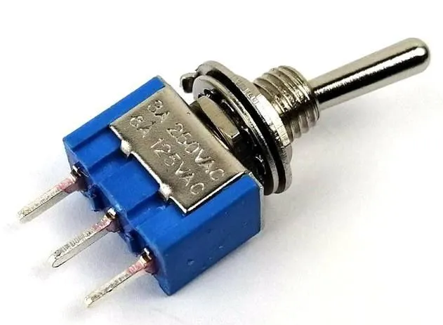
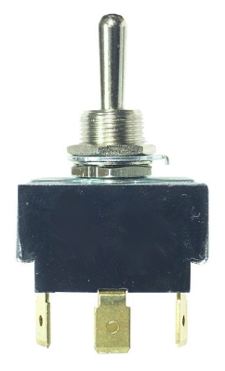
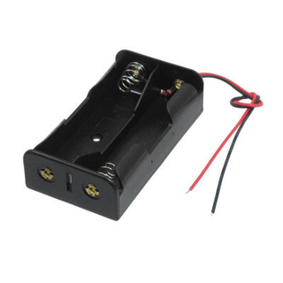
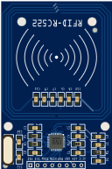
Voice Control System
Arduino
Door Lock Servo
Left Sonar
(Range 15cm)
Manual Control
System
Voice Control
Back
Sonar
(Range
30cm)
Manual
Control
Remove the connectors
Front Sonar
Door Lock system
ON
(Range 30cm)
Manual control system
ON
Voice control system ON
Door Lock system
OFF
OFF
Right Sonar
Manual to Voice Control Motor Driver Shifting Mechanism Switches
Two 3.7V Li-ion battery
(Range 15cm)
Door Security System Arduino

